Slide 1

Time variability of Cosmic Rays
Guilherme Simplício

Slide 2
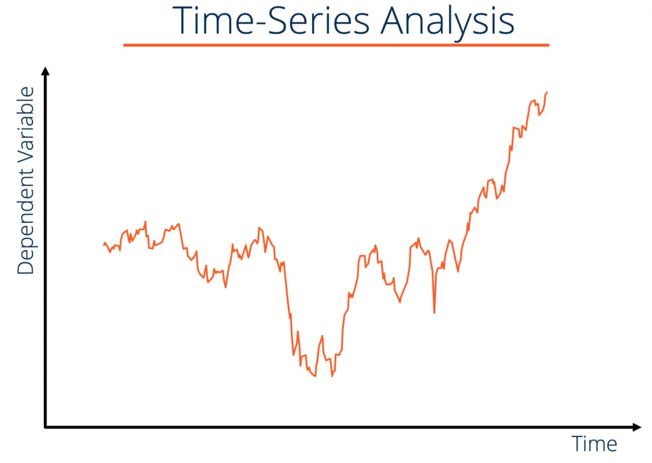
Time variable data
x(t)
• space data: sun activity, neutron monitors, cosmic rays fluxes;
• earth data: meteorological (temperature, sea currents, . . . )
• finance: stock options

Slide 3
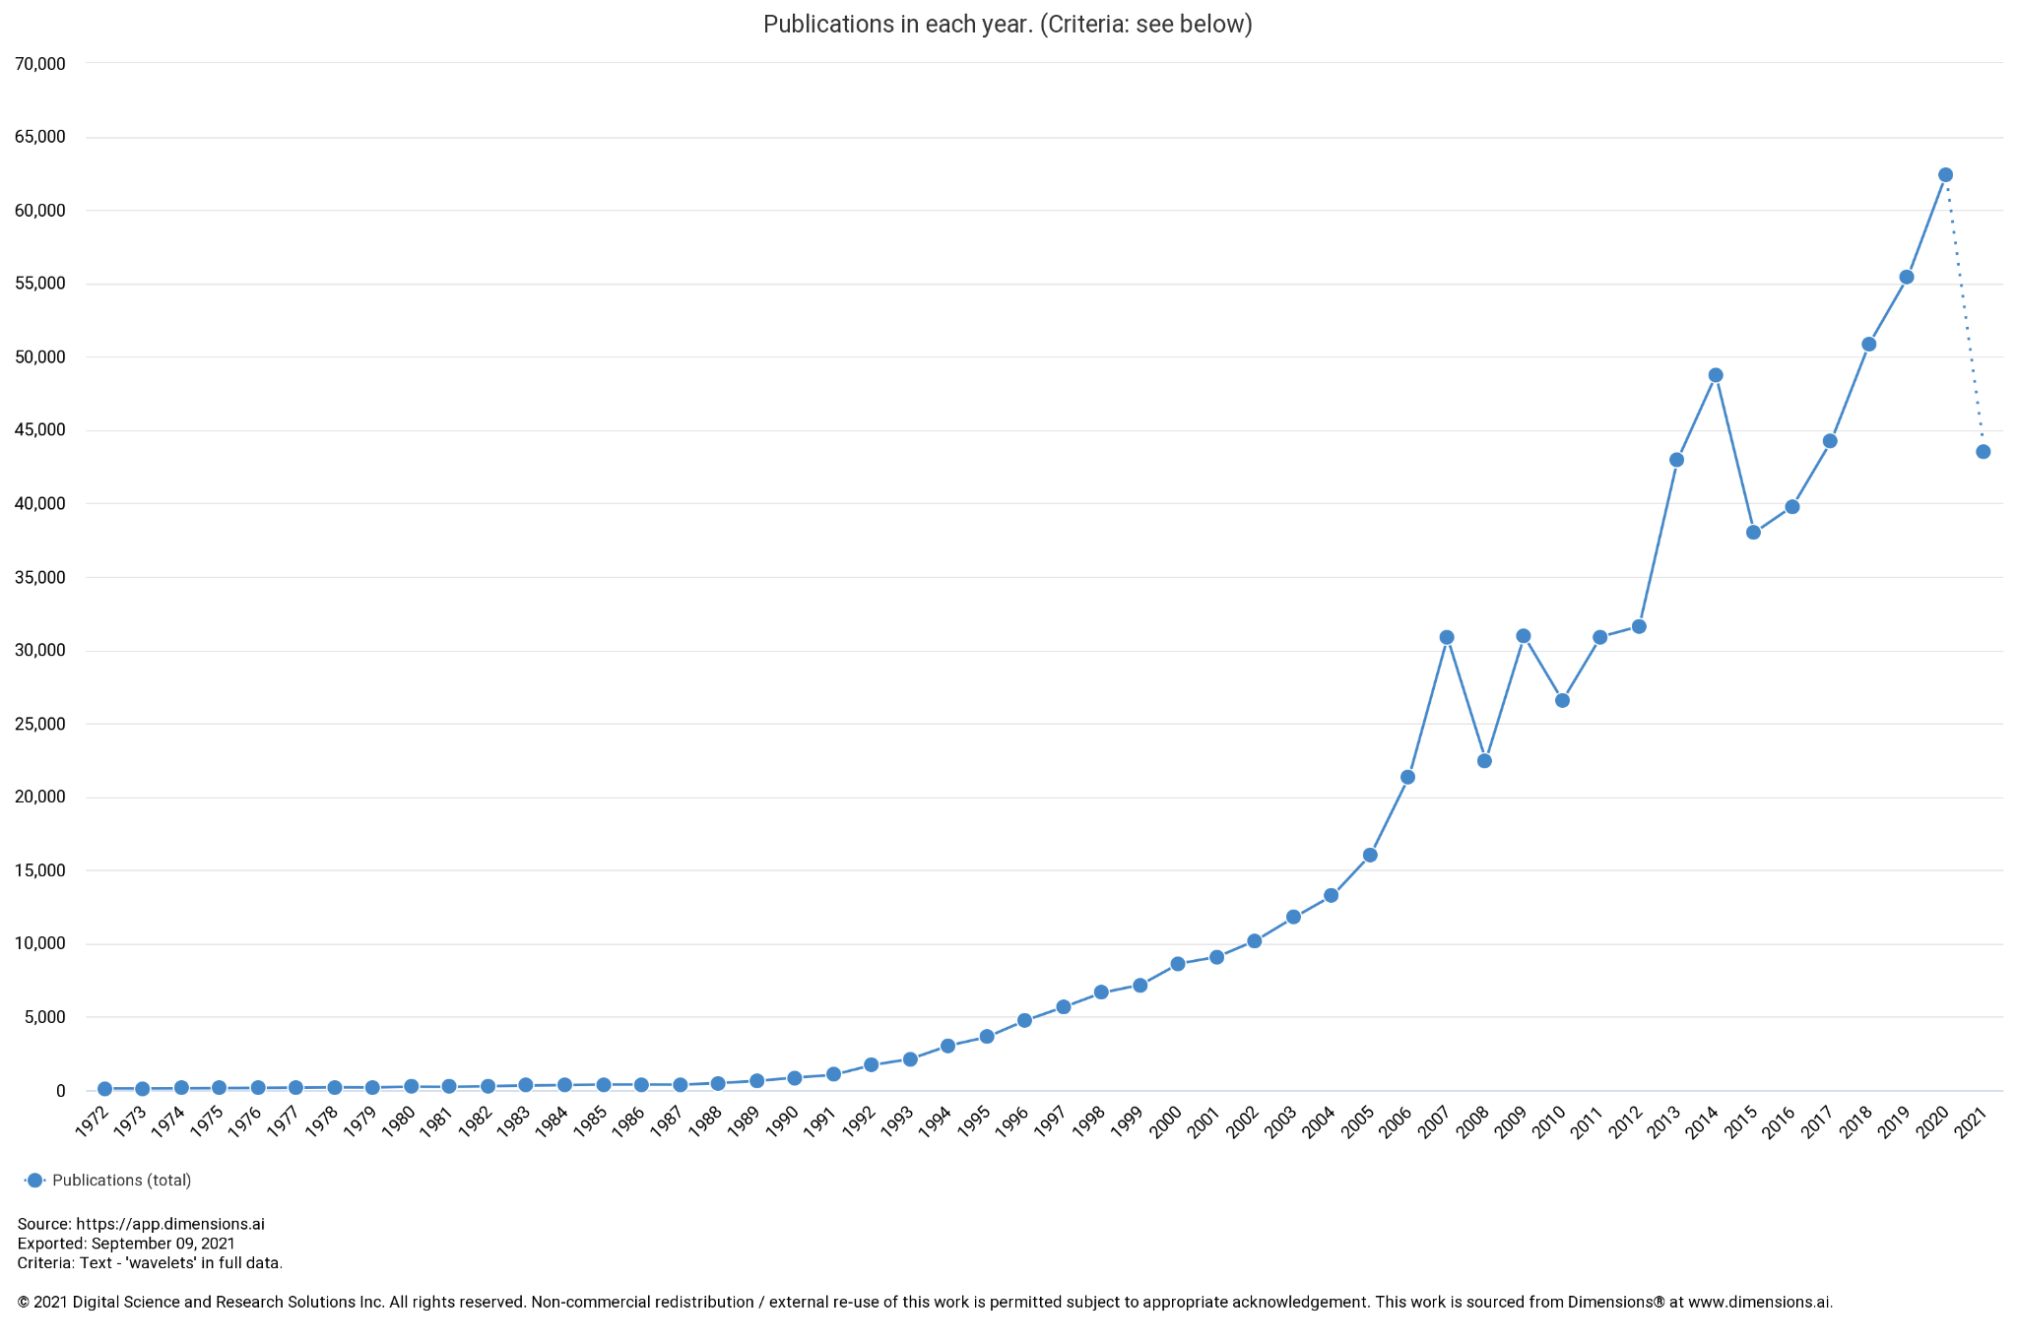
Most common tools for data characterization
• autocorrelation methods;
• Fourier series;
• wavelets: emerged as powerful tool.

Slide 4
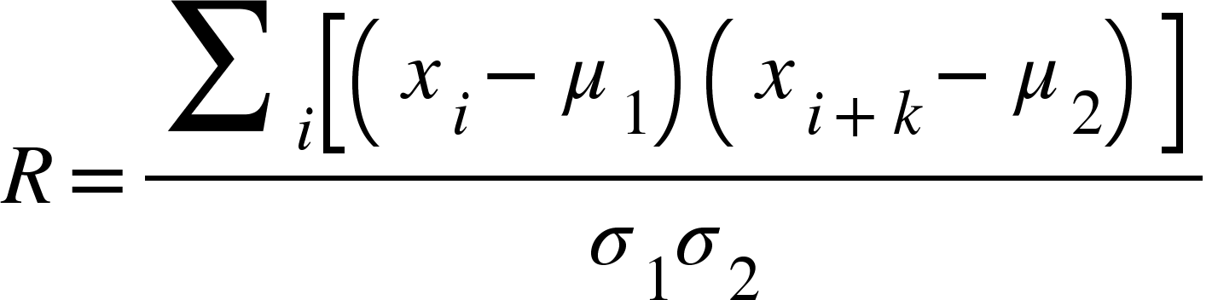
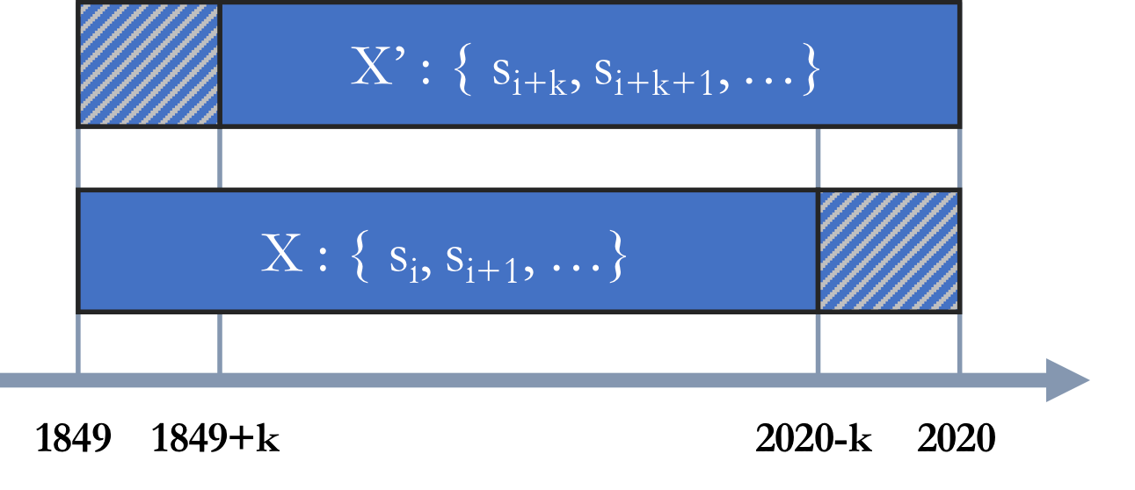
Autocorrelation in short...
Autocorrelation is a mathematical representation of the degree of similarity between a given time series and a lagged version of itself over successive time intervals.
R:Autocorrelation coefficient
𝜇₁: average of sample X
𝜇₂: average of sample X’
σ ₁, σ₂ : Standard deviation of the two samples
k: time-shift

Slide 5
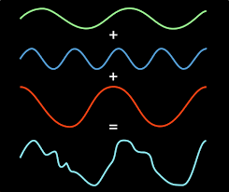
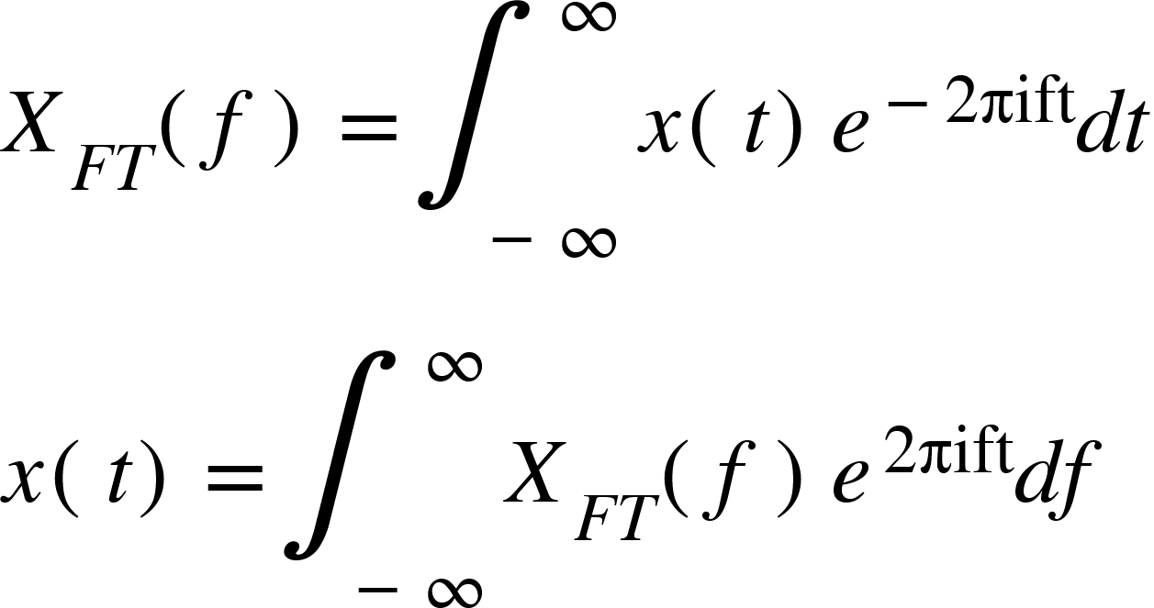
Fourier Series in short...
• In 1807, a French mathematician (Joseph Fourier) discovered that a periodic function can be represented by an infinite sum of complex exponentials;
• The Fourier Transform(FT) is probably the most widely used signal analysis method;
• The Fourier transform retrieves the global information of the frequency content of a signal.
• Analyses time series as a whole, but what if the frequency varies with time?

Slide 6
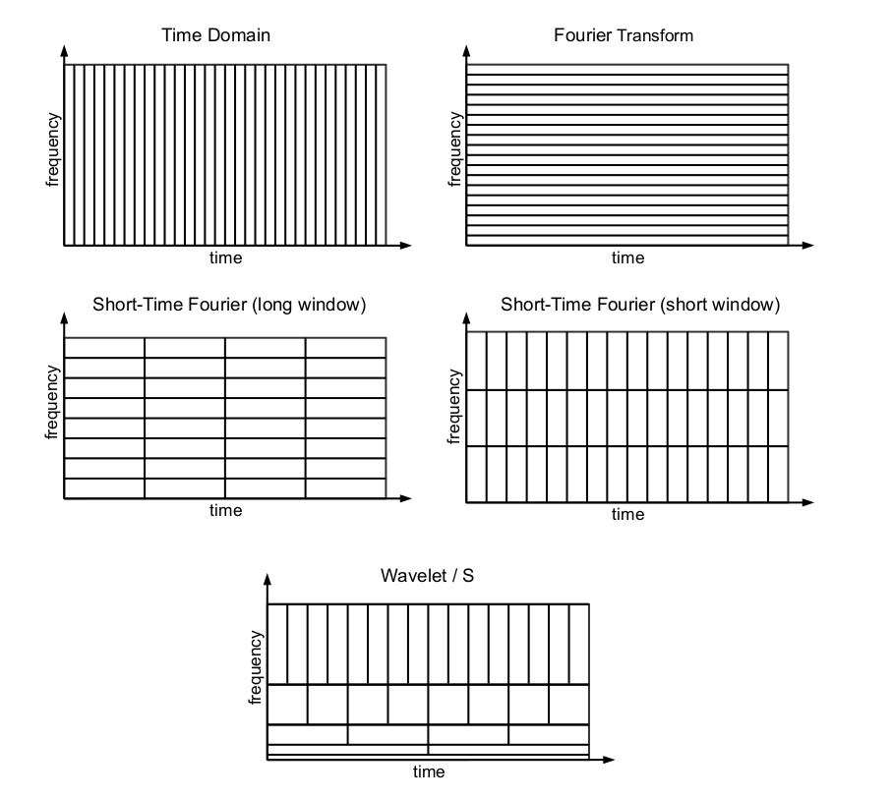
Wavelets
• The analysis of a non-stationary signal using the FT or the STFT does not give satisfactory results;
• Better results can be obtained using wavelet analysis(basically an extension of fourier analysis);
• One advantage of wavelet analysis is the ability to perform local analysis( trends, breakdown points, discontinuities,...), so there’s no problem if the frequency changes throughout the time series;
•While the Fourier transform creates a representation of the signal in the frequency domain, the wavelet transform creates a representation of the signal in both the time and frequency domain, thereby allowing efficient access of localized information about the signal.

Slide 7
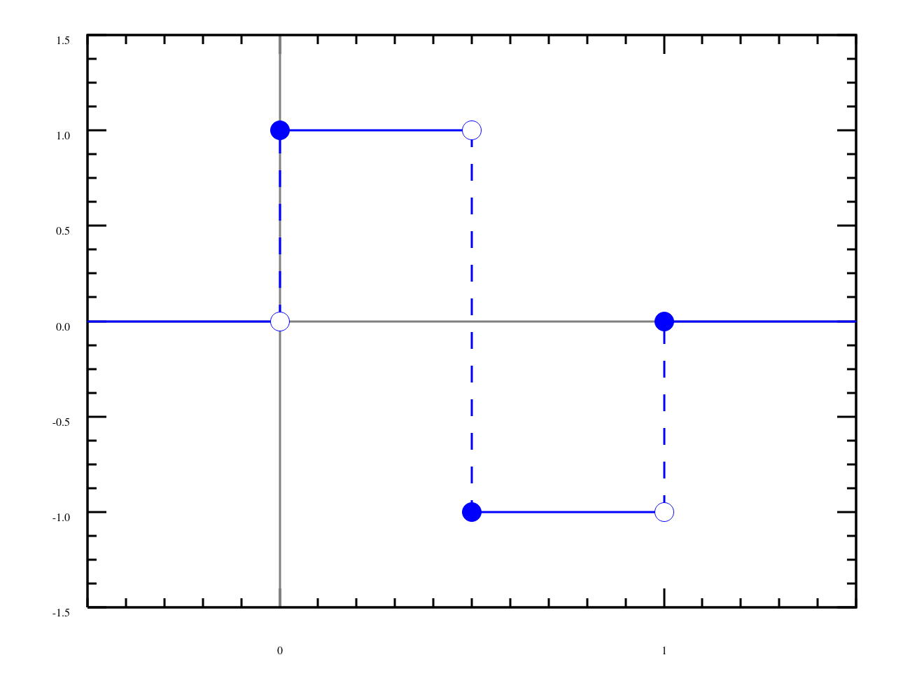
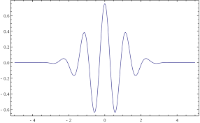
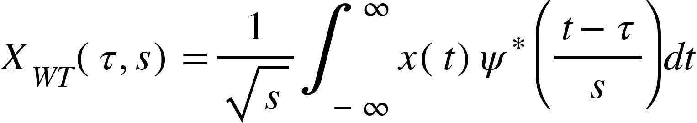
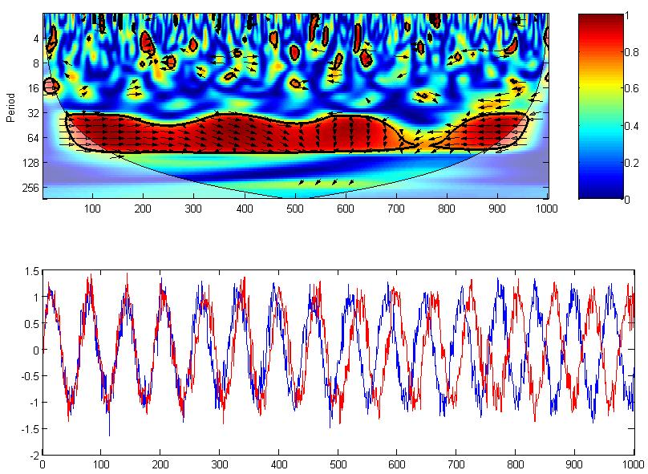
Wavelets
Haar Wavelet:
Morlet Wavelet:
τ: translation parameter
s: scale parameter
Ѱ: mother wavelet
* : complex conjugate
Note: Mother wavelets must have null mean, amongst other criteria.

Slide 8
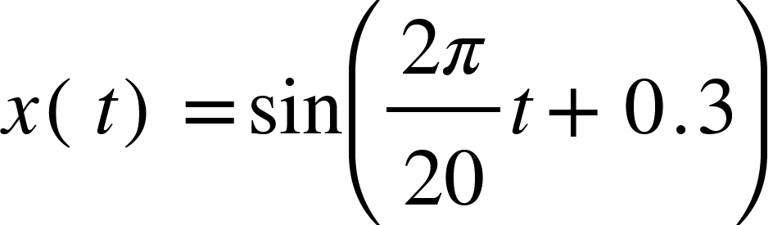
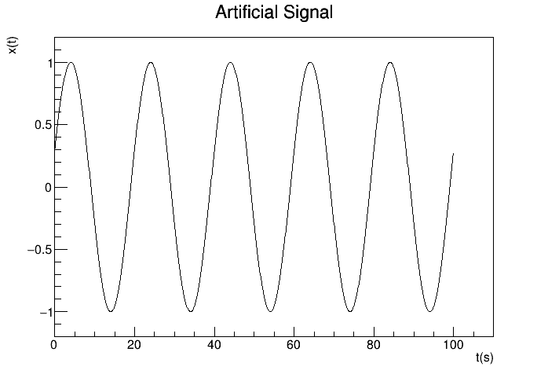
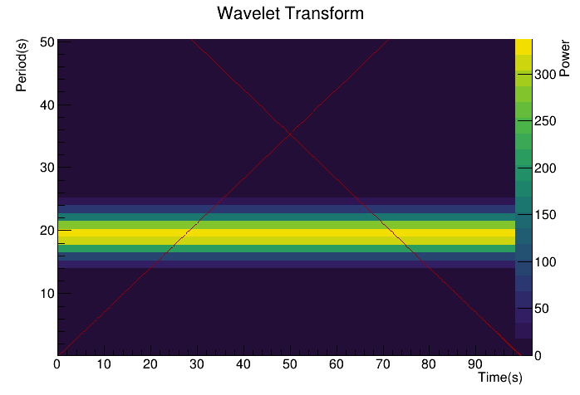
Wavelets for a monochromatic signal
Parameter | value
N_points | 1000
Δt | 0.1 s

Slide 9
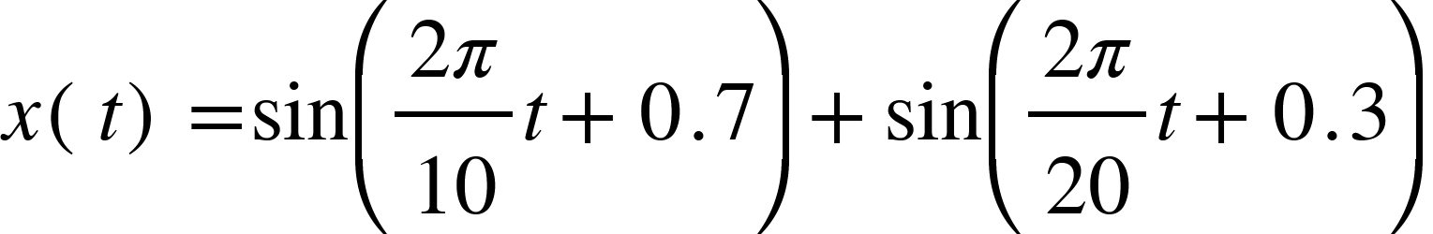
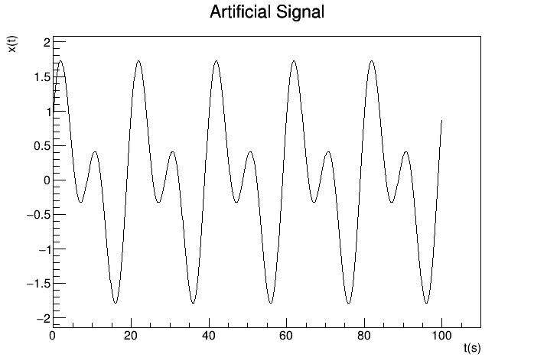
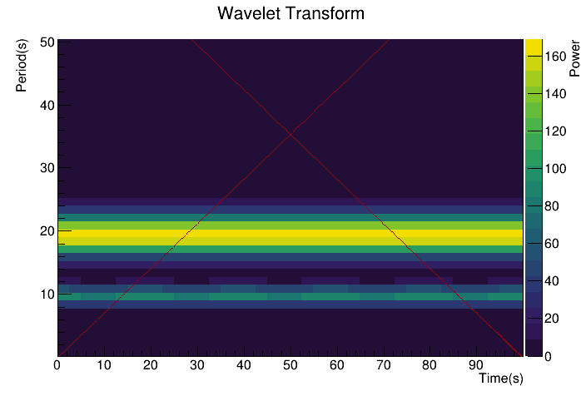
Wavelets for an artificial signal
Parameter | value
N_points | 1000
Δt | 0.1 s

Slide 10
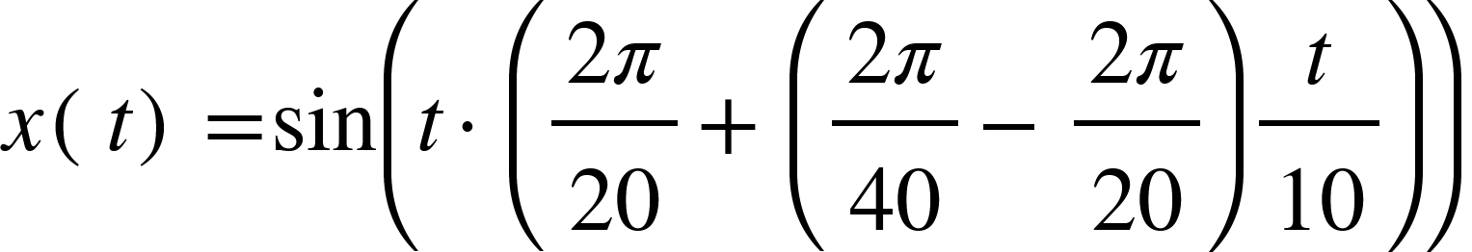
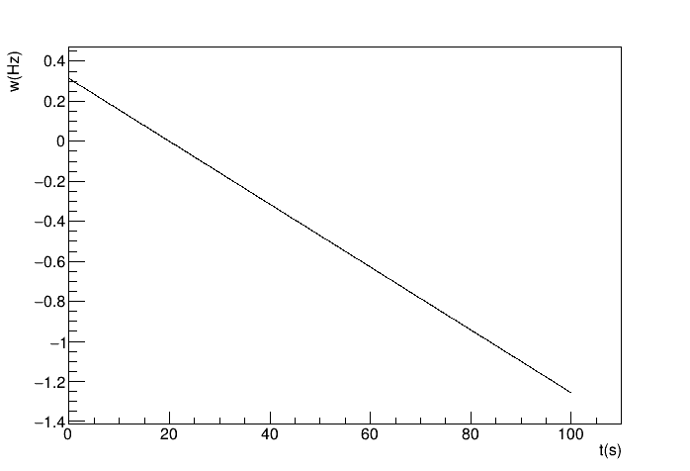
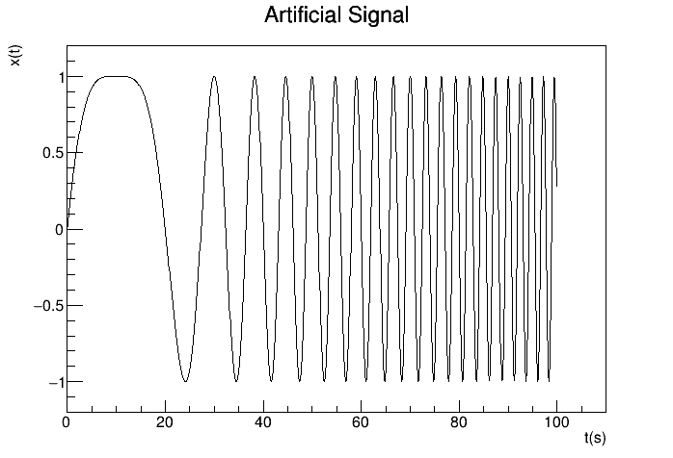
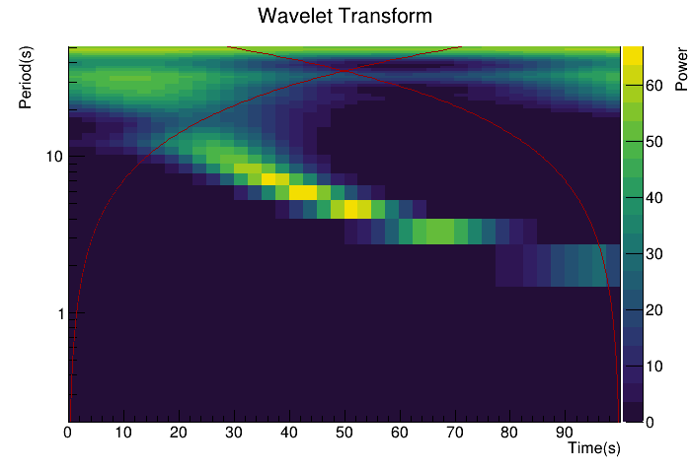
Wavelets for ...
Parameter | value
N_points | 1000
Δt | 0.1 s
Frequency w

Slide 11
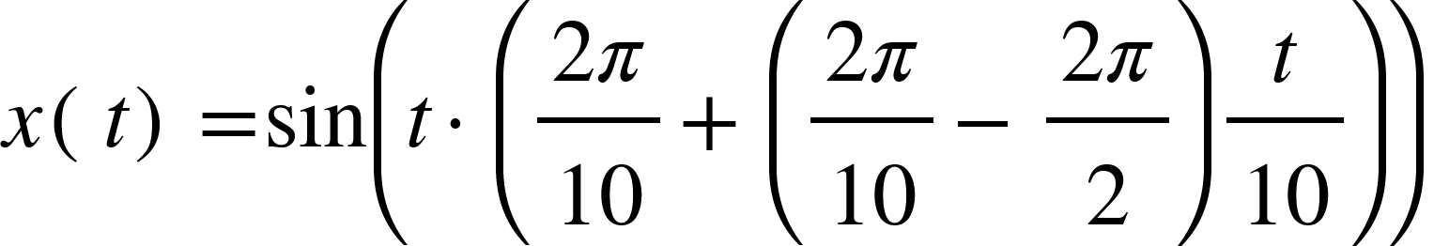
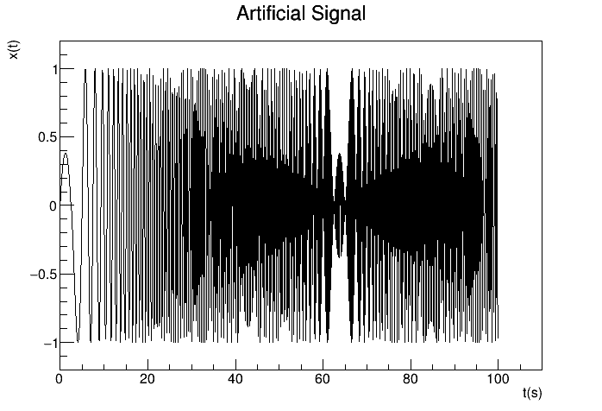
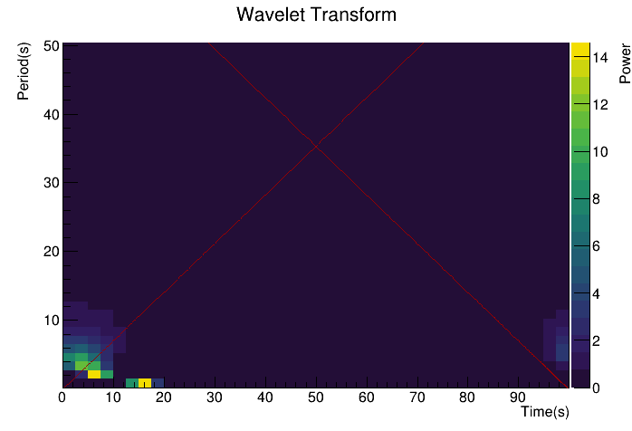
Wavelets for an artificial signal
(done wrong)
Parameter | value
N_points | 1000
Δt | 0.1 s

Slide 12
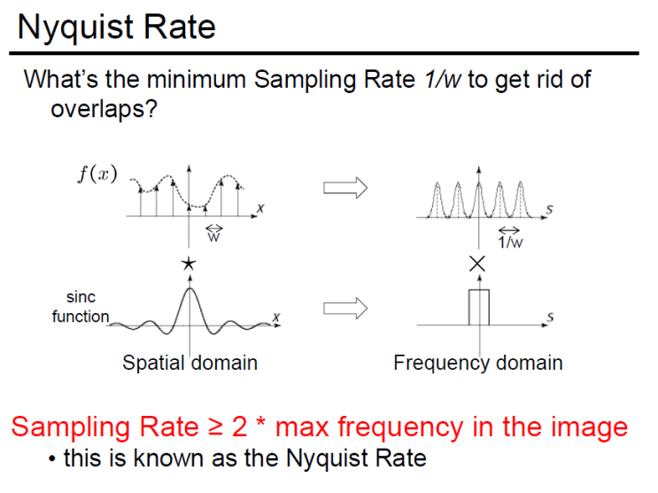
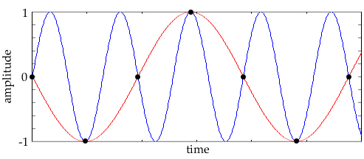
Nyquist rate...

Slide 13
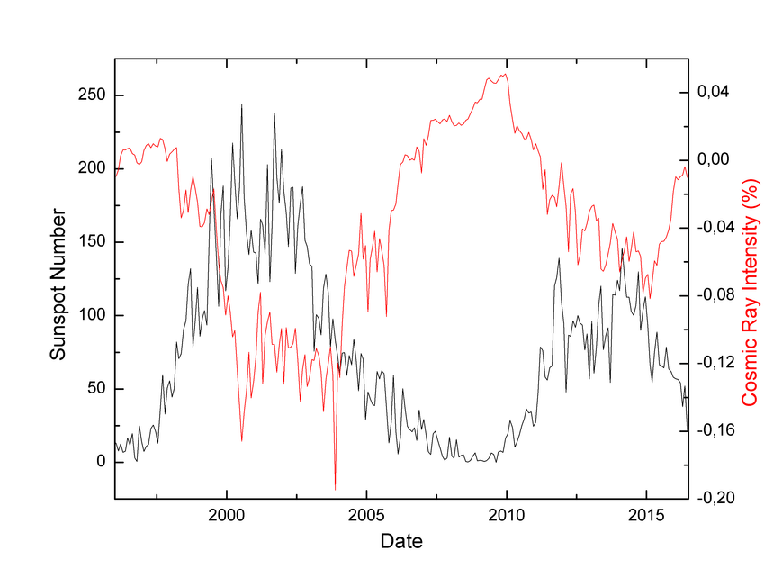
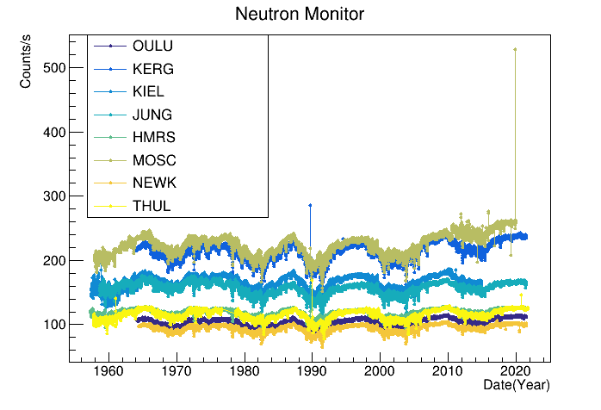
NMReader Class
What are neutron monitors ?
Neutron monitors and Solar Sunspot number are anti-correlated;
The 8 stations with over 20,000 entries were chosen;
Why are there different counts/s in different stations?

Slide 14
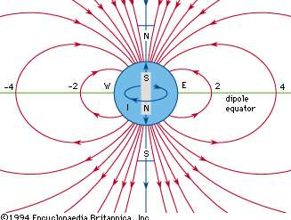
Neutron Monitor and the Earth’s Magnetic Field
What actually happens depends on the latitude and the inclination at which the cosmic ray encounters the magnetosphere: around the poles is a small region where the magnetic field lines are more or less radial. If the particle comes in radially there, it will have unhindered access to the atmosphere. If it encounters the magnetosphere in the equatorial plane, it hits the magnetic field where its shielding is most effective, and the cutoff energy E0 the highest. Particles with energies just above the cutoff may have a very complex orbit before they reach the atmosphere.

Slide 15
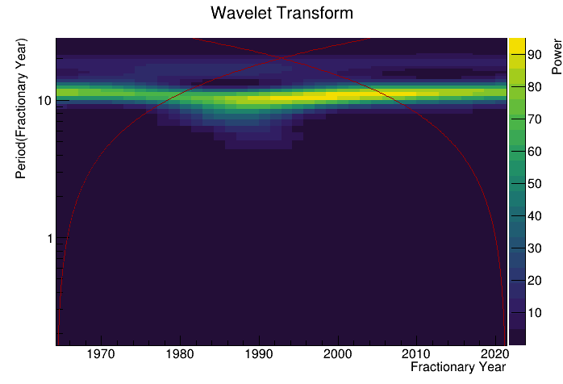
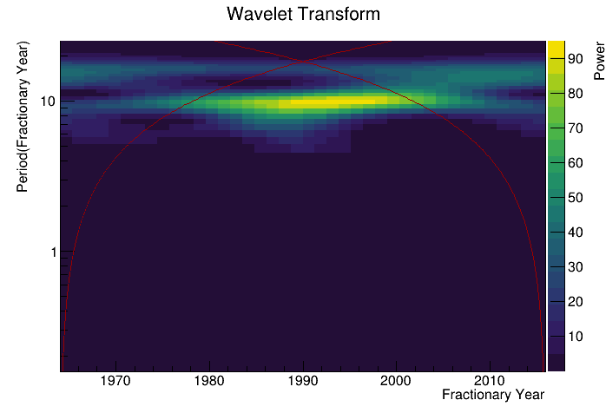
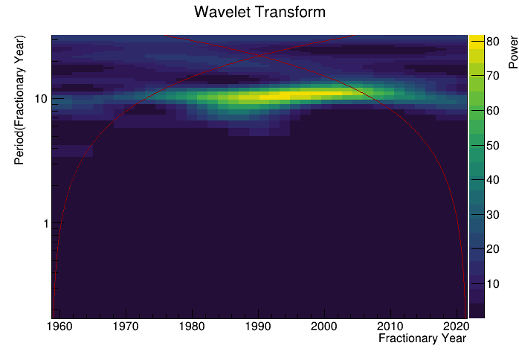
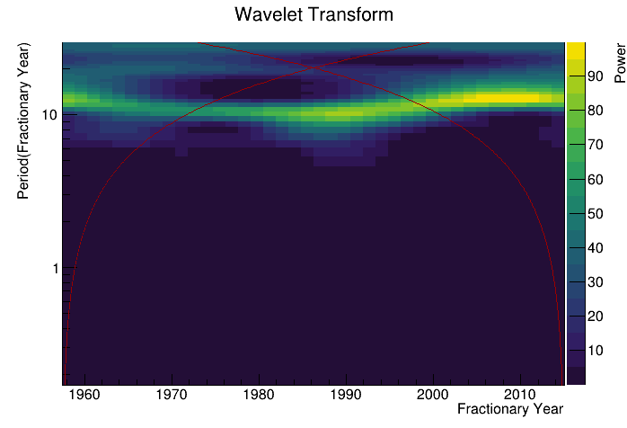
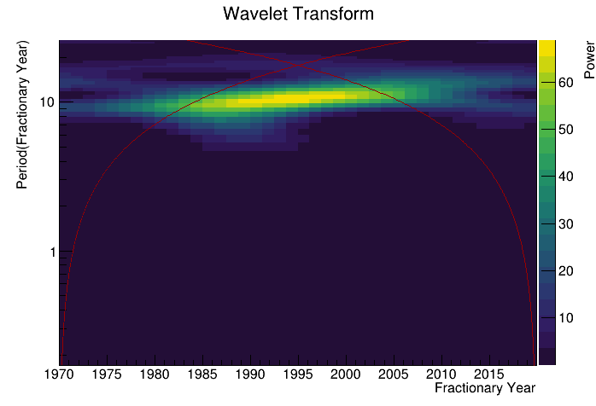
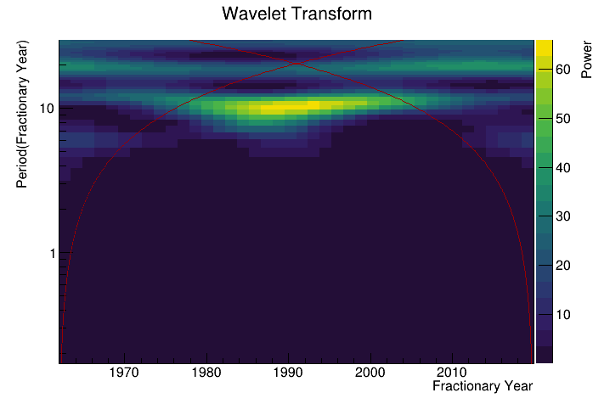
Neutron Monitor
Periodograms
OULU
KERG
Station | Initial Date | Date Ending
OULU | 31/3/1964 | 17/7/2021
KERG | 29/1/1964 | 1/1/2016
KIEL | 1/7/1957 | 1/9/2021
JUNG | 30/9/1958 | 1/9/2021
HMRS | 1/1/1970 | 1/1/2020
MOSC | 1/1/1962 | 1/9/2021
KIEL
JUNG
HMRS
MOSC

Slide 16
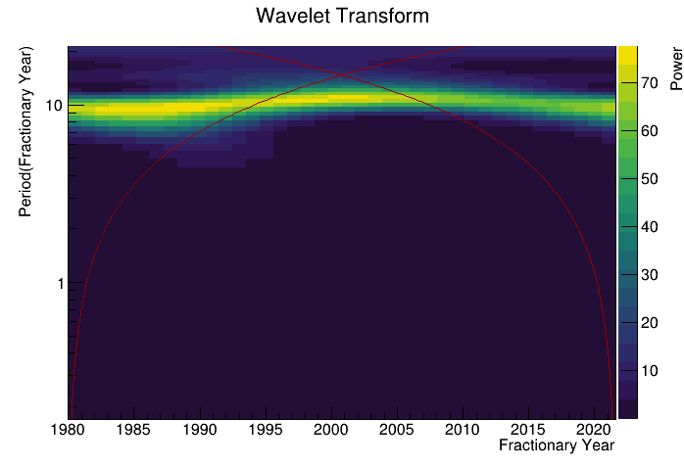
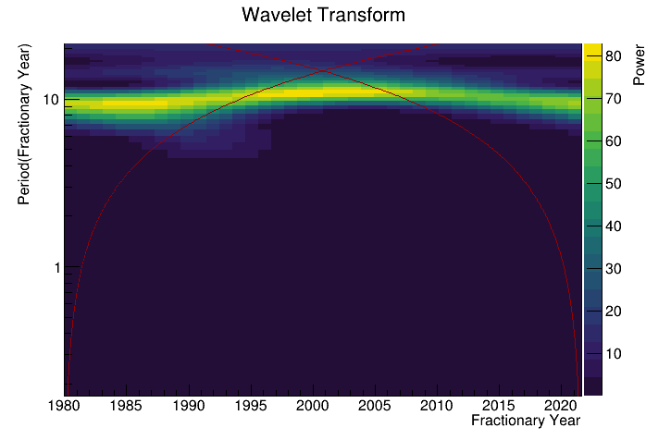
Neutron Monitor
Periodograms
Station | Initial Date | Date Ending
NEWK | 1/1/1980 | 1/1/2021
THUL | 1/1/1980 | 1/1/2021
All stations provide us with the same periodicity of ~11 years;
Only 40-60 years of data, which means only 4-6 cycles, more data would improve this study;
This periodicity is coherent with 11 year sunspot cycle.
NEWK
THUL

Slide 17
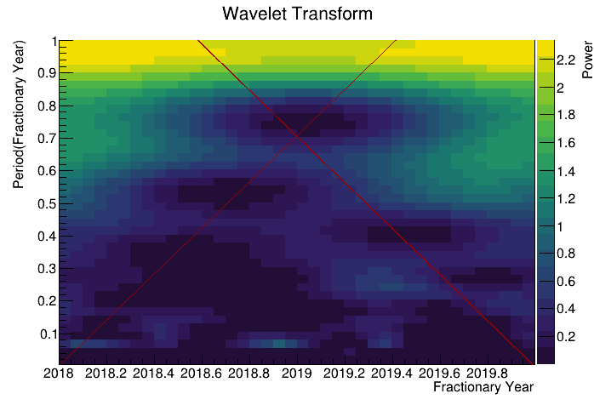
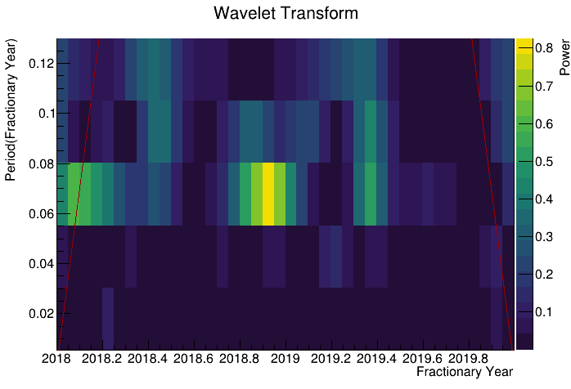
Different timeframes (for OULU)
ZOOMING
Searching for the sun rotation period(27 days).
Note that 27/365.25~0.07

Slide 18
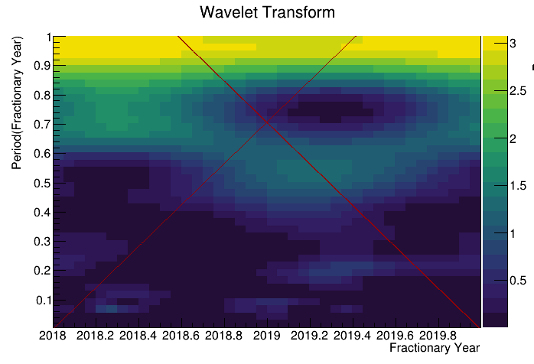
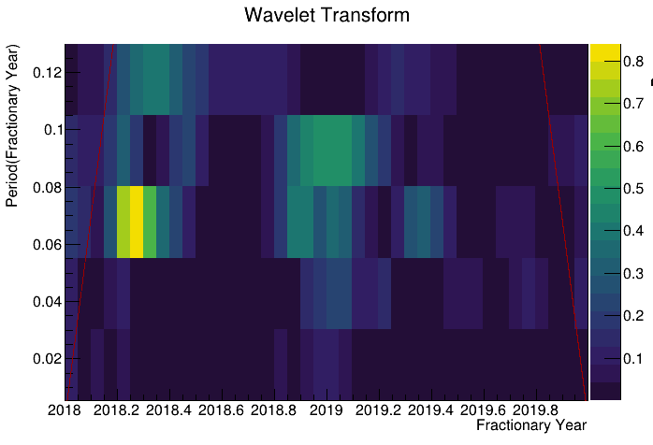
Different timeframes (for JUNG)
ZOOMING
Searching for the sun rotation period(27 days).
Note that 27/365.25~0.07

Slide 19
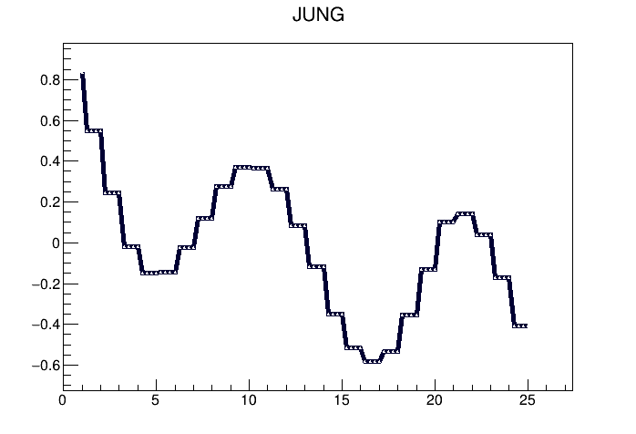
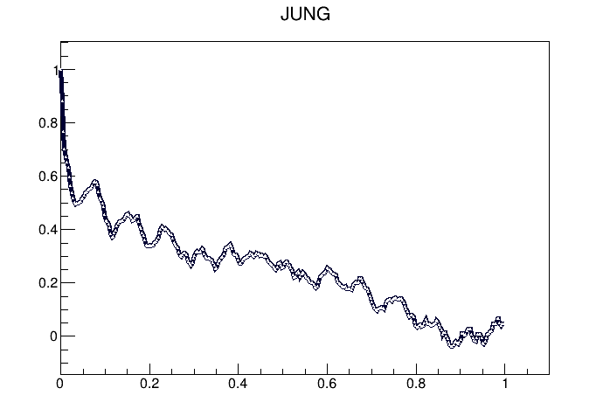
Autocorrelation vs Wavelets
(Autocorrelation graphs for JUNG station)
R
R
t(years)
t(years)
~11 years

Slide 20
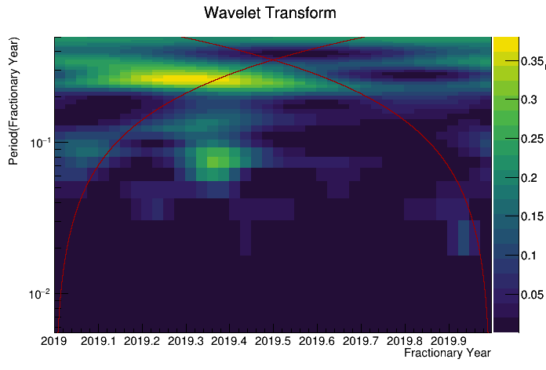
Next Steps...
Create TimeSeries class to store time series from classes such as NMReader and others(SSNReader, IMFReader,...) and feed them to the Wavelets analysis class;
Statistical treatment of data could be better, by estimating significance levels of our results;
With better statistical treatment try to validate the 27 days periodicity;
Analise AMS Data with Wavelets class;
Add Background Noise(red noise/white noise);

Slide 21
Conclusions
Although it has its limitations, wavelets is a very powerful tool ;
It has multiple applications and I am looking forward to continue to improve the class and to study much more phenomena with it ;
Special thank you to my supervisors: Fernando Barão and Miguel Orcinha !

